Slide 1
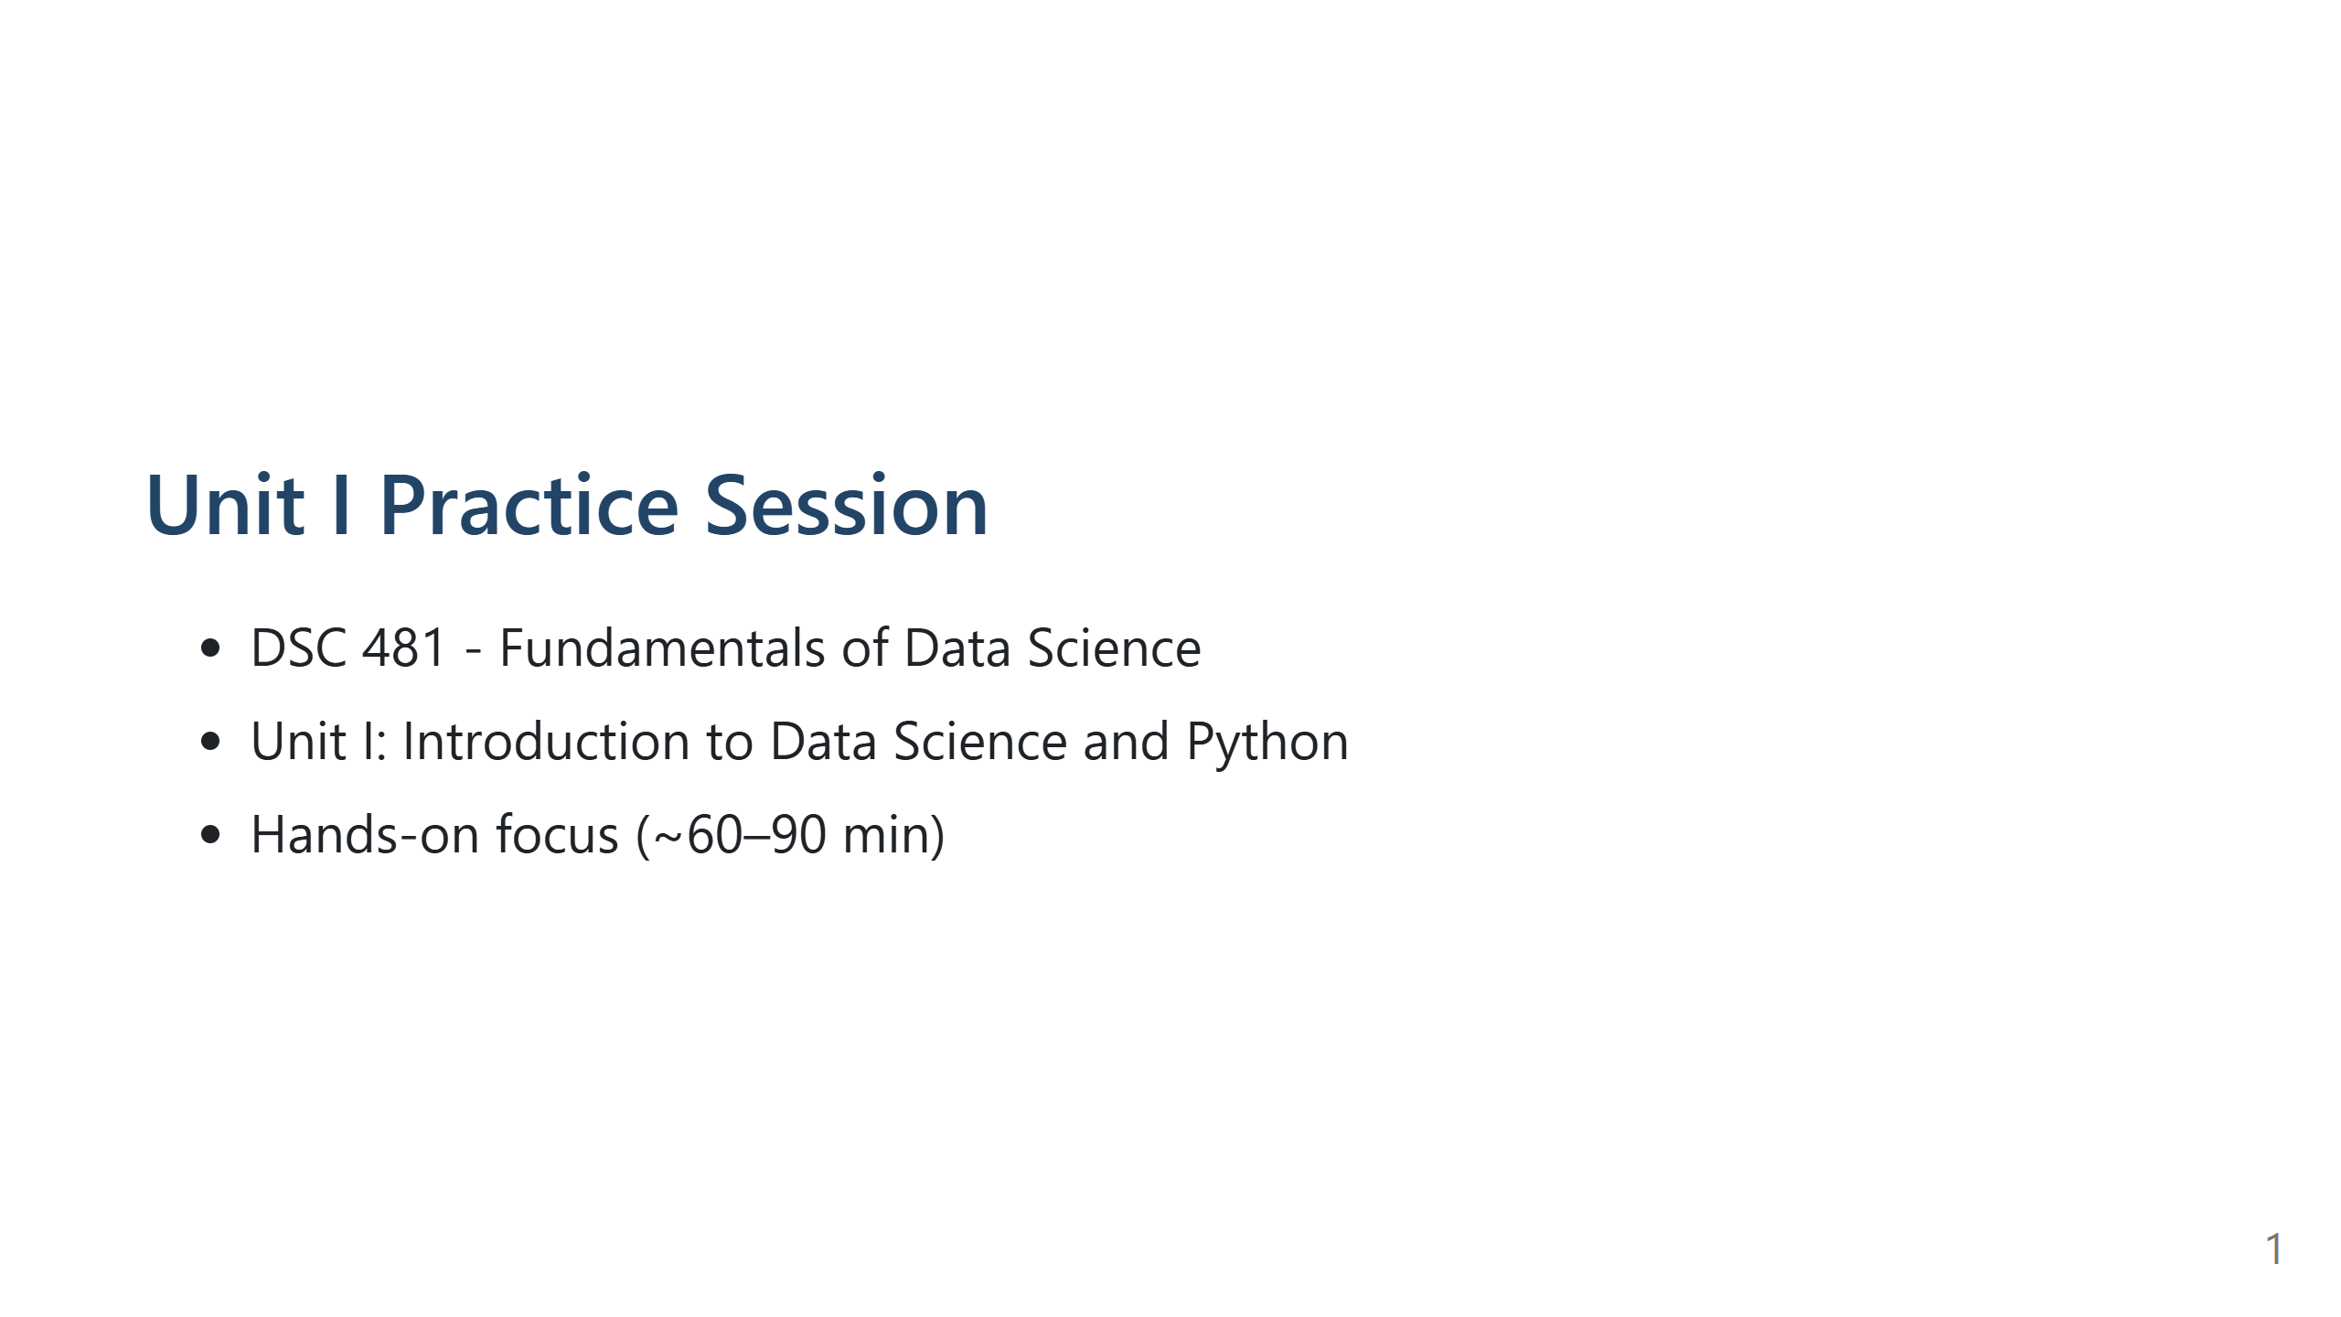
Notes:
Speaker Notes:
Overview: Reinforce Python basics and environment use.
Students create notebook: Unit_I_Practice.ipynb.

Slide 2
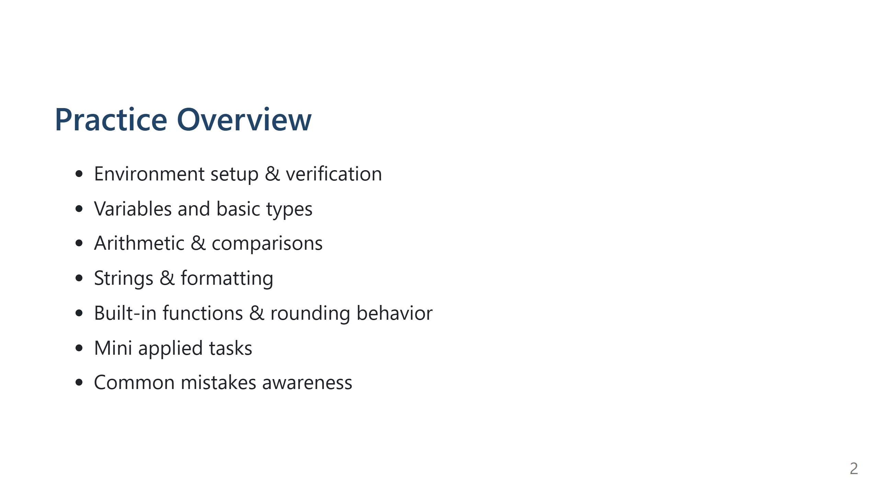
Notes:
Speaker Notes:
Set expectations: attempt first, show solutions later verbally or from notes.

Slide 3
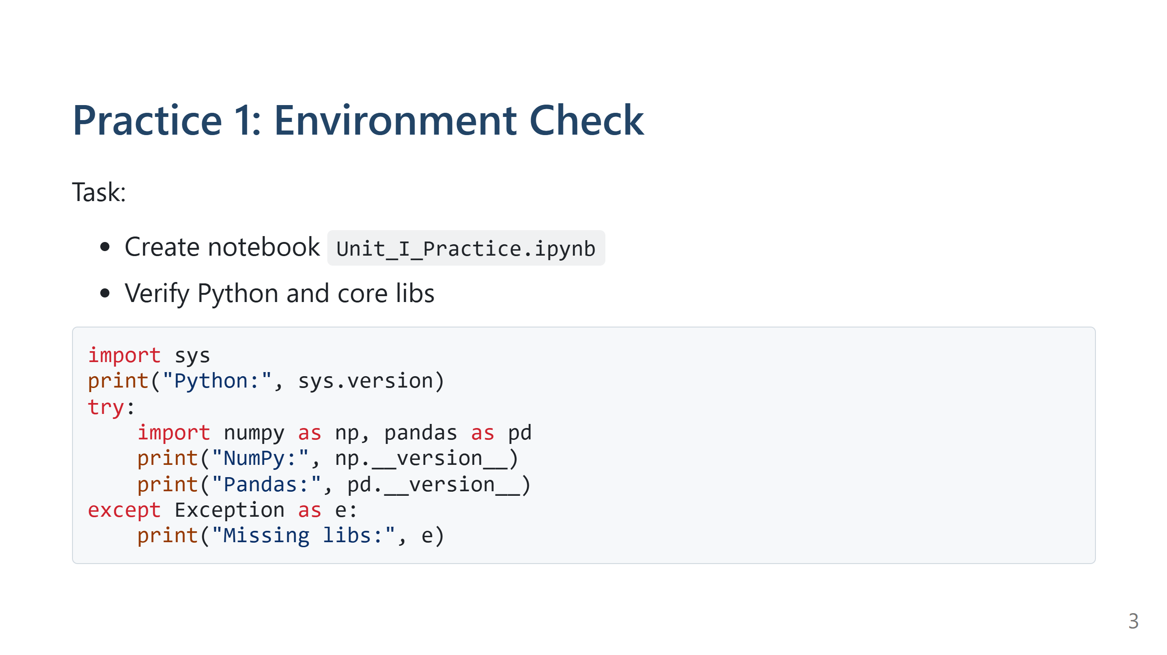
Notes:
Speaker Notes:
Answer: Shows Python & library versions or missing message.
If missing: Colab -> !pip install numpy pandas; Local -> pip install numpy pandas.

Slide 4
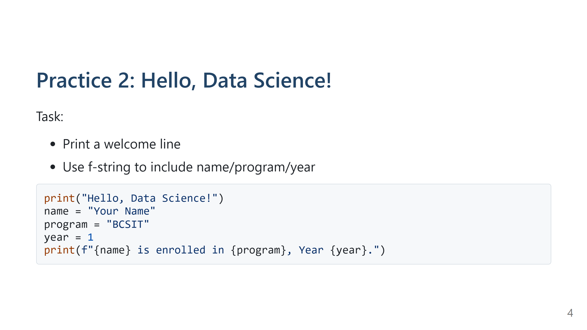
Notes:
Speaker Notes:
Two lines output. Reinforce f-string syntax.

Slide 5
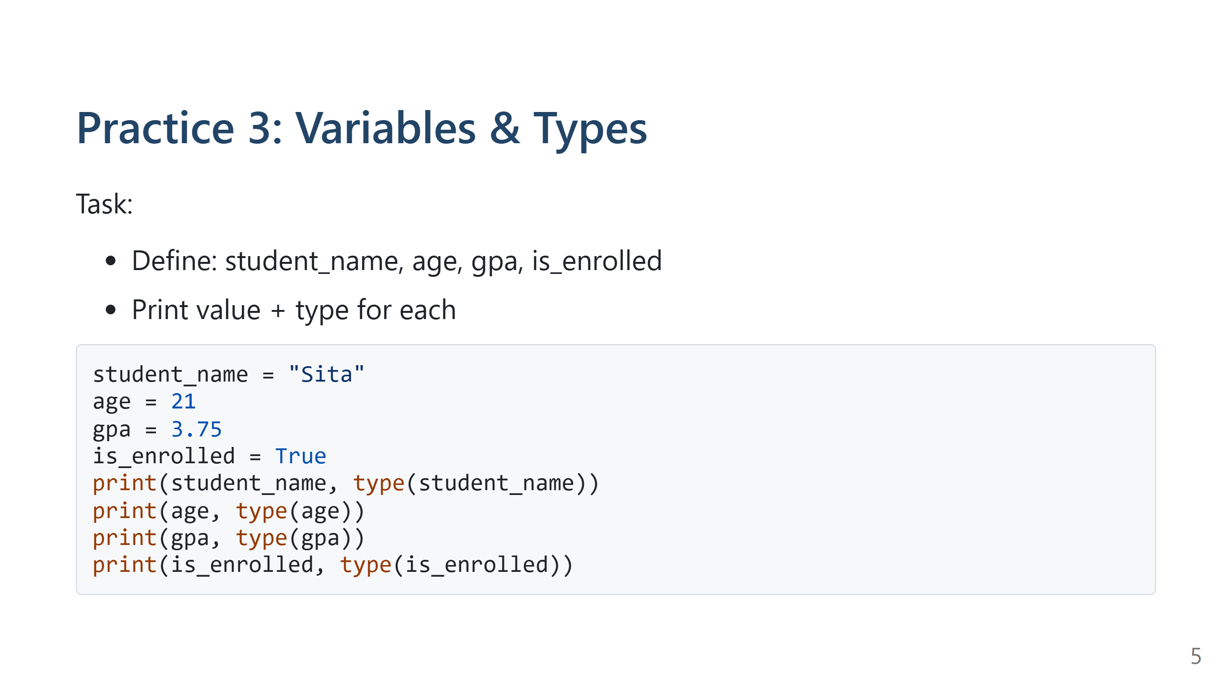
Notes:
Speaker Notes:
Types: str, int, float, bool. Changing age to "21" makes it str.

Slide 6
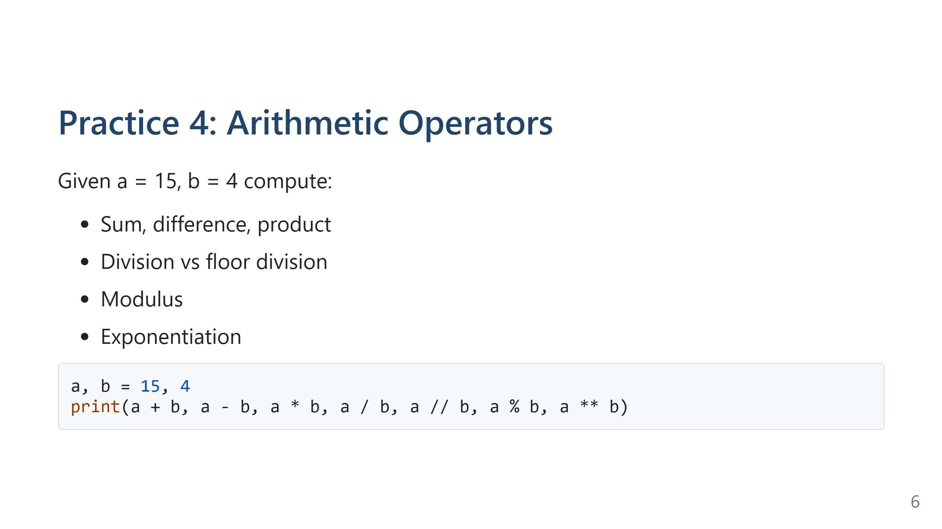
Notes:
Speaker Notes:
Answers: 19,11,60,3.75,3,3,50625.

Slide 7
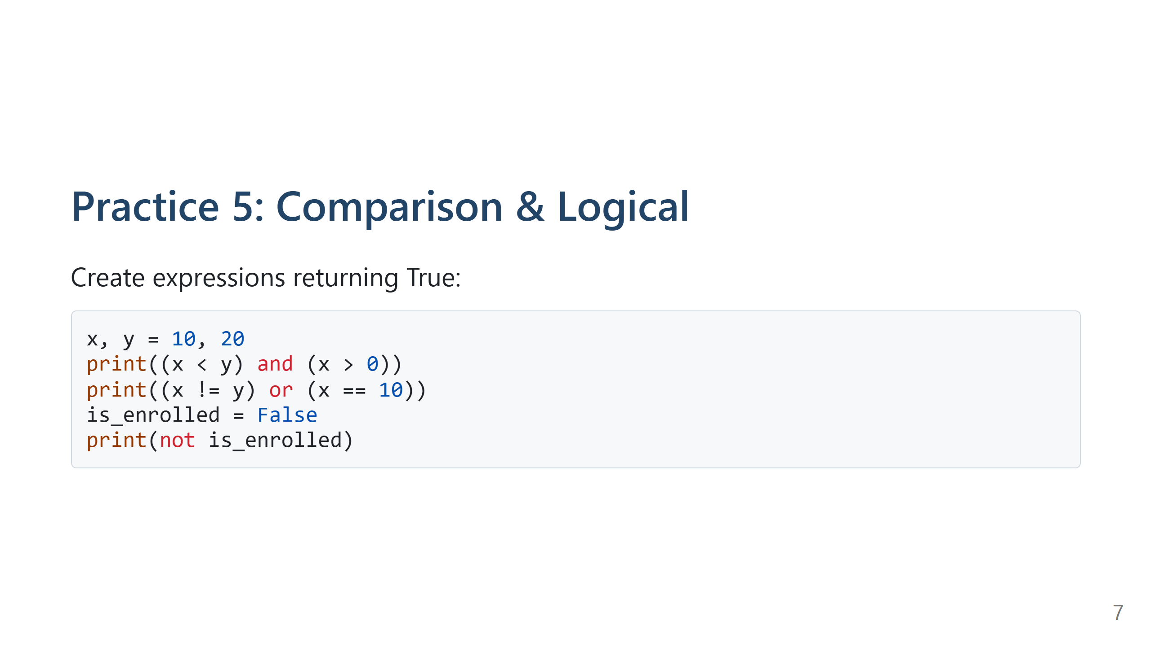
Notes:
Speaker Notes:
All True. Discuss short-circuit evaluation.

Slide 8
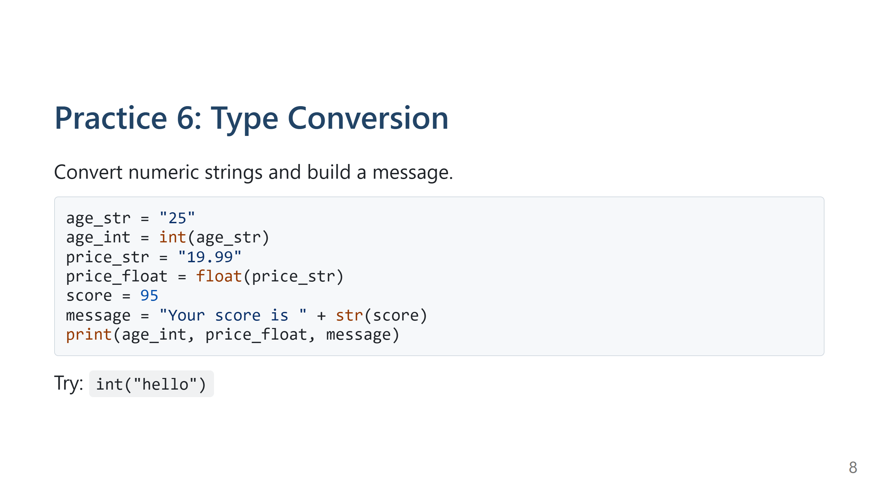
Notes:
Speaker Notes:
ValueError for int("hello").

Slide 9
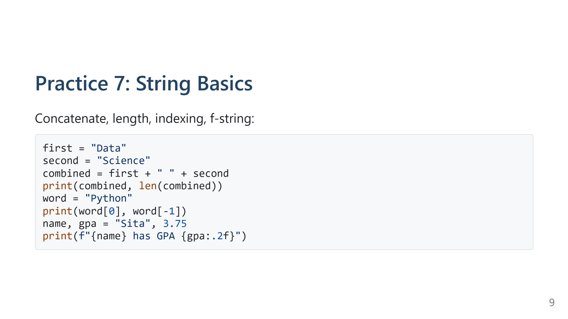
Notes:
Speaker Notes:
"Data Science" length 12; 'P', 'n'.

Slide 10
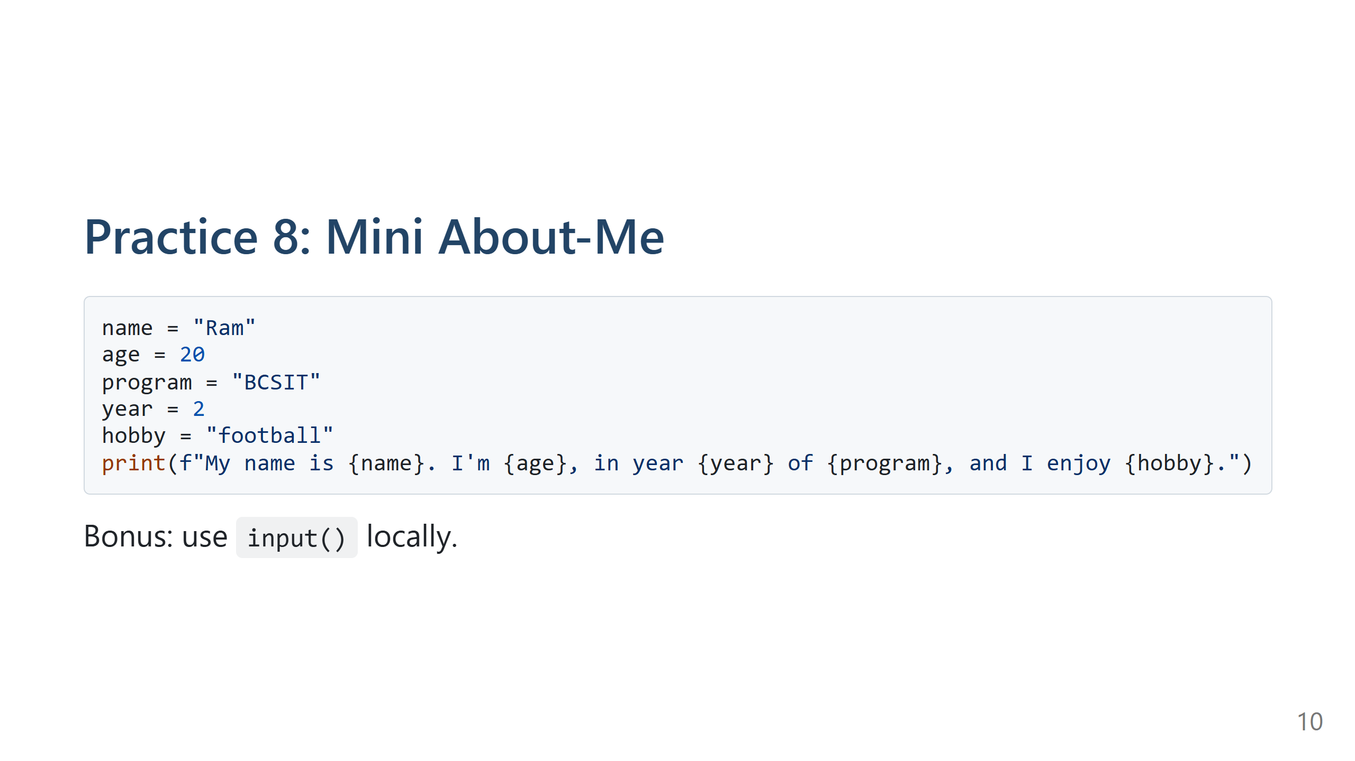
Notes:
Speaker Notes:
Simple personal profile; avoid input() in automated settings.

Slide 11
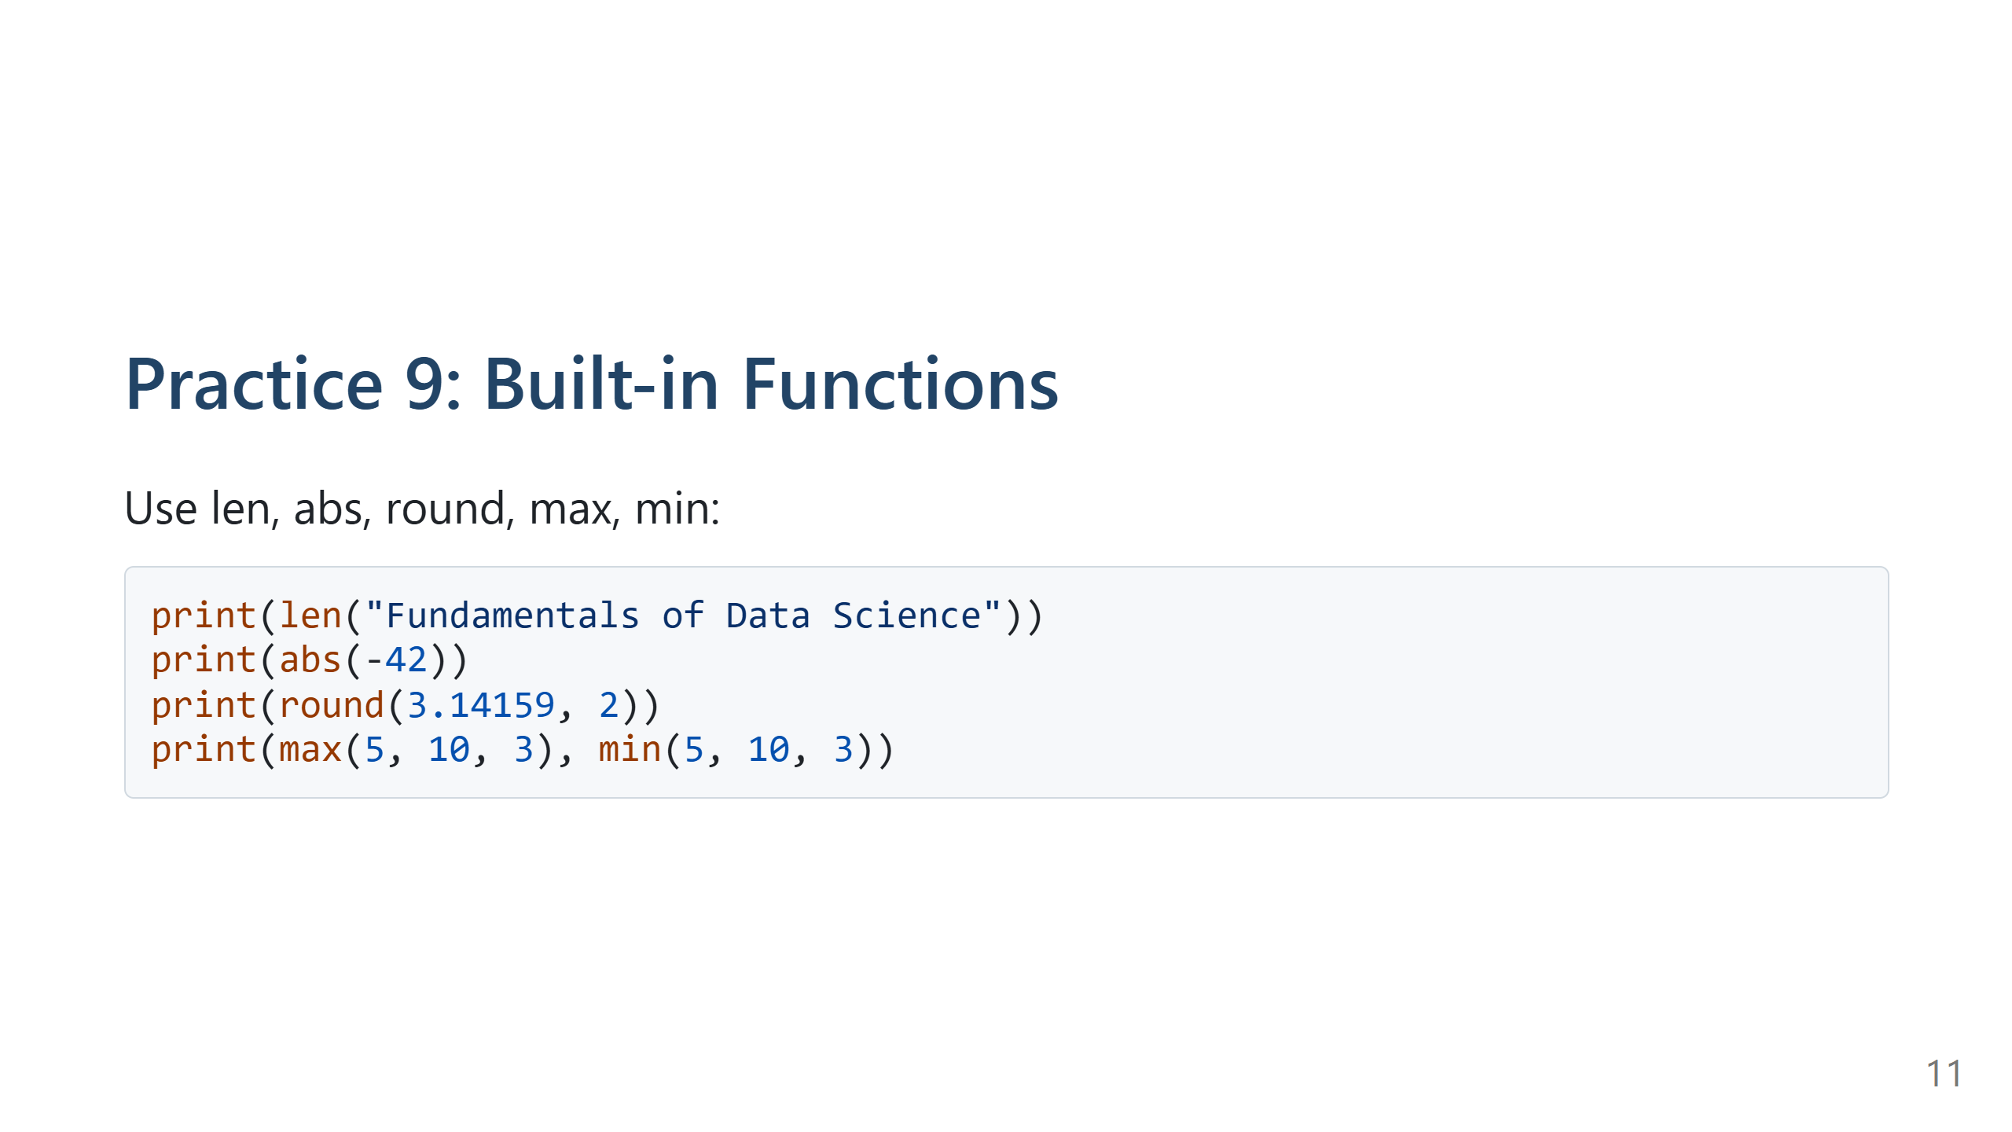
Notes:
Speaker Notes:
28, 42, 3.14, 10 & 3.
Mention banker’s rounding will matter for .5 cases.

Slide 12
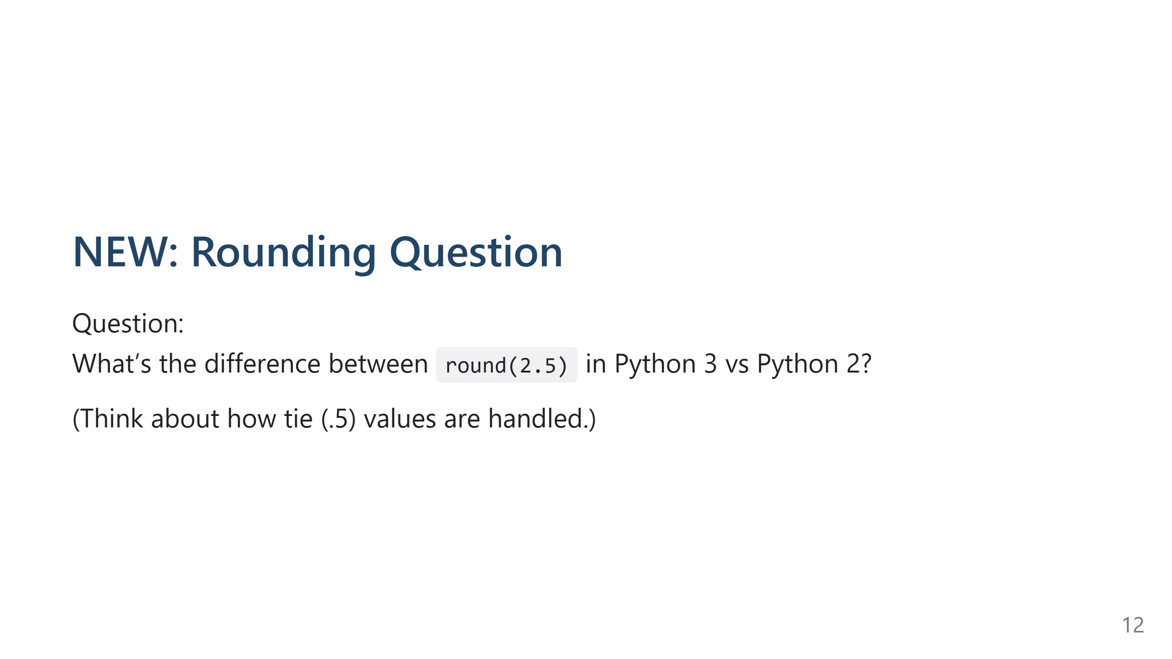
Notes:
Speaker Notes:
Answer:
Python 2 (half-away-from-zero for positives): round(2.5) -> 3.0 (float)
Python 3 (half-to-even, banker’s): round(2.5) -> 2 (int)
Examples Python 3: round(3.5)=4, round(-2.5)=-2.
Purpose: Reduce cumulative bias. Demonstrate loop:
for n in [1.5,2.5,3.5,4.5]: print(round(n)) -> 2,2,4,4.
Half-up via decimal:
from decimal import Decimal, ROUND_HALF_UP
Decimal('2.5').quantize(Decimal('1'), rounding=ROUND_HALF_UP) -> Decimal('3')

Slide 13
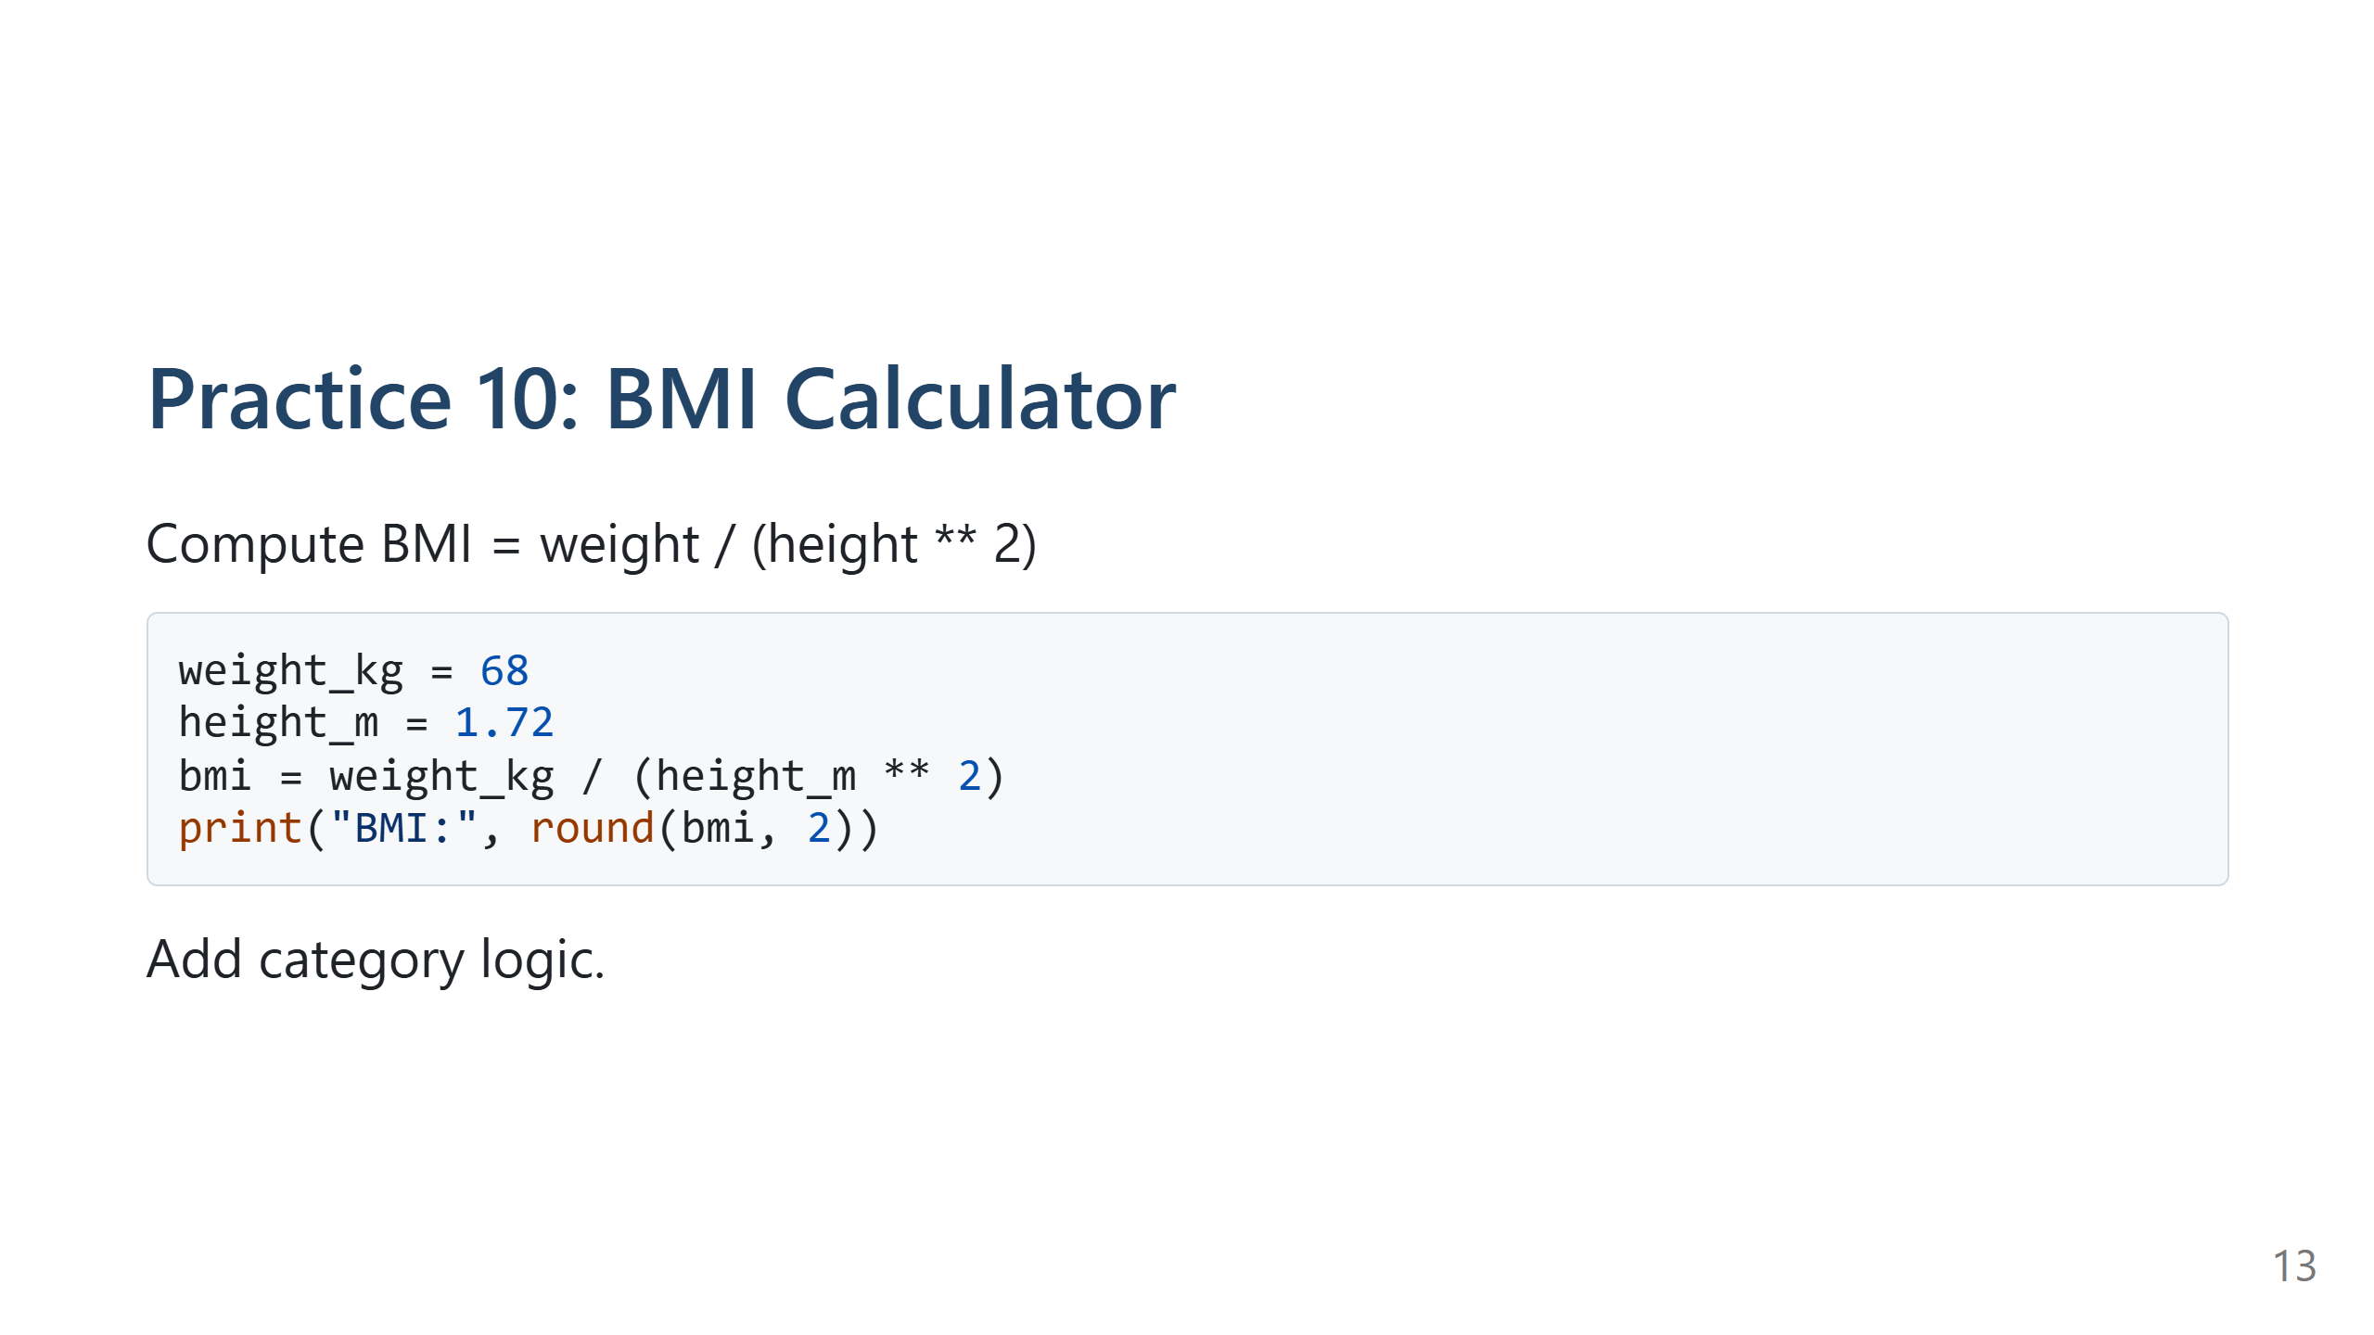
Notes:
Speaker Notes:
BMI ≈ 22.99 Normal.
Categorization chain:
if bmi < 18.5: Underweight
elif bmi < 25: Normal
elif bmi < 30: Overweight
else: Obese

Slide 14
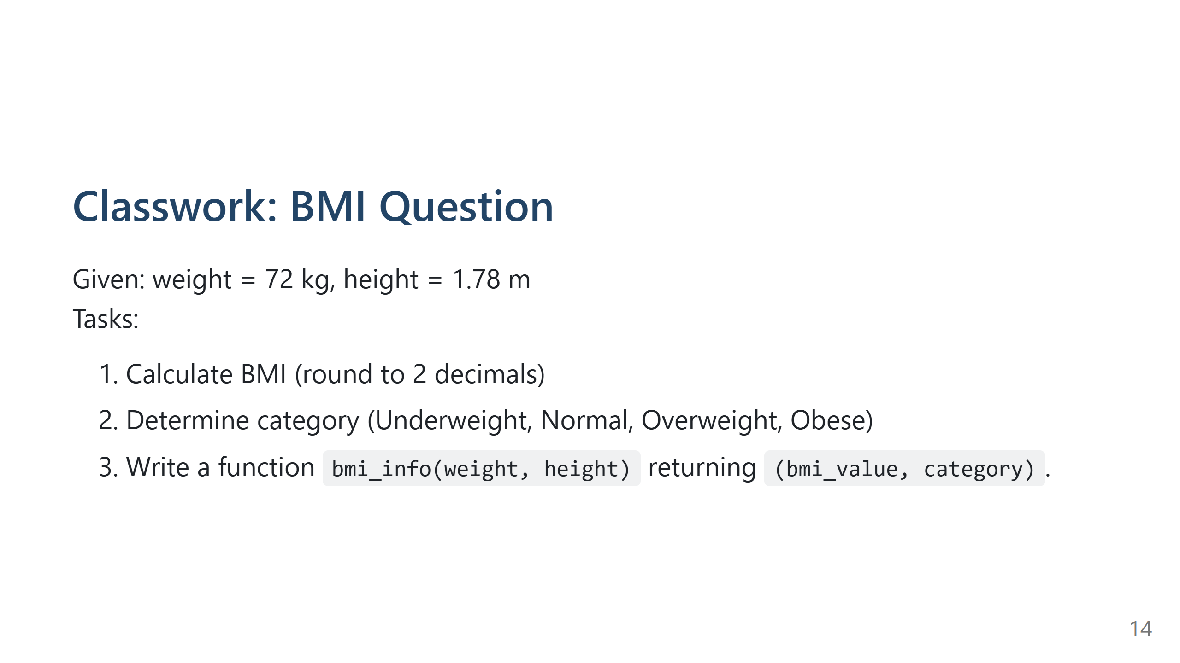
Notes:
Speaker Notes:
Answer:
BMI = 72 / (1.78**2)
1.78**2 = 3.1684
72 / 3.1684 ≈ 22.7247 → round(...,2) = 22.72
Category: Normal (18.5 ≤ BMI < 25)
Function example:
def bmi_info(weight, height):
bmi = weight / (height ** 2)
if bmi < 18.5:
cat = "Underweight"
elif bmi < 25:
cat = "Normal"
elif bmi < 30:
cat = "Overweight"
else:
cat = "Obese"
return round(bmi, 2), cat
print(bmi_info(72, 1.78)) # (22.72, 'Normal')
Teaching point: Show rounding difference if using Decimal for exact.

Slide 15
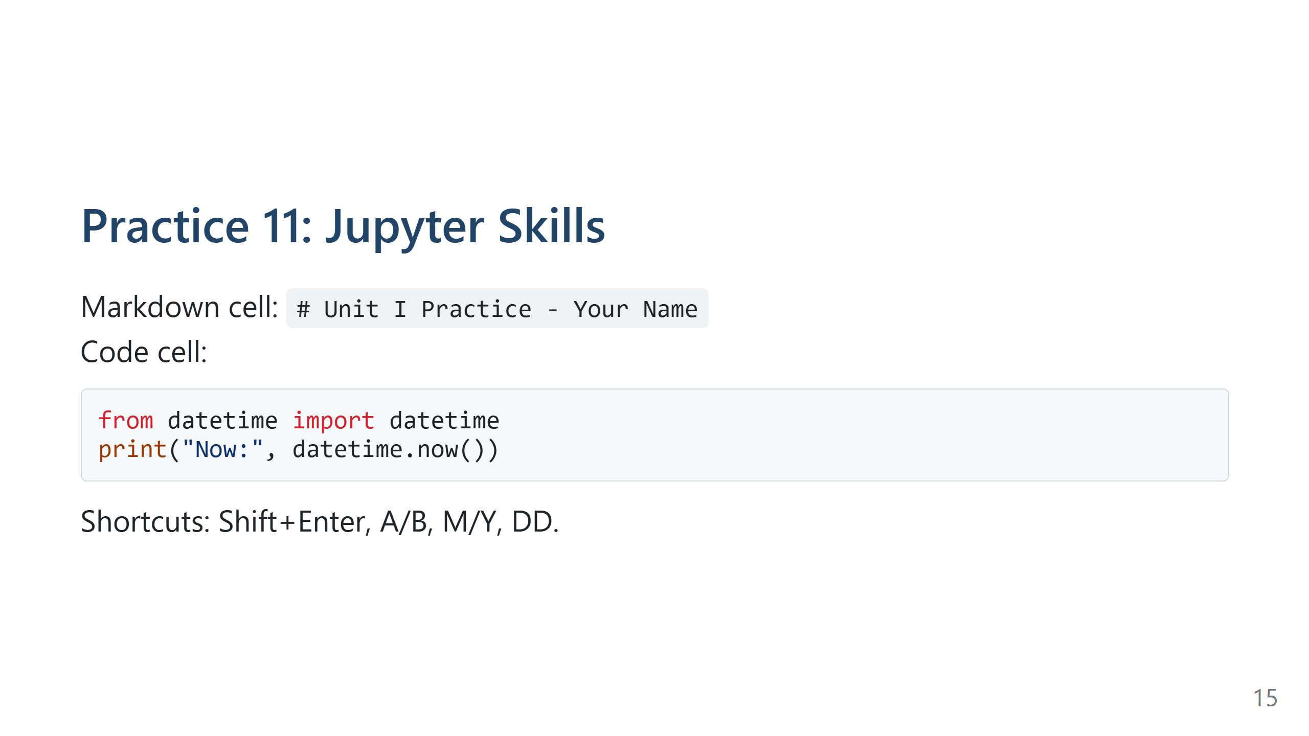
Notes:
Speaker Notes:
Stress reproducibility & documentation.

Slide 16
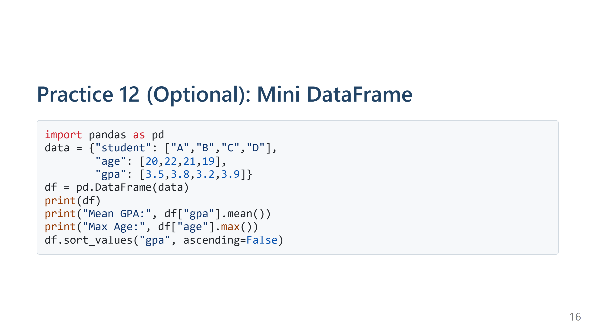
Notes:
Speaker Notes:
Mean GPA 3.6; Max age 22; Sort order D,B,A,C.

Slide 17
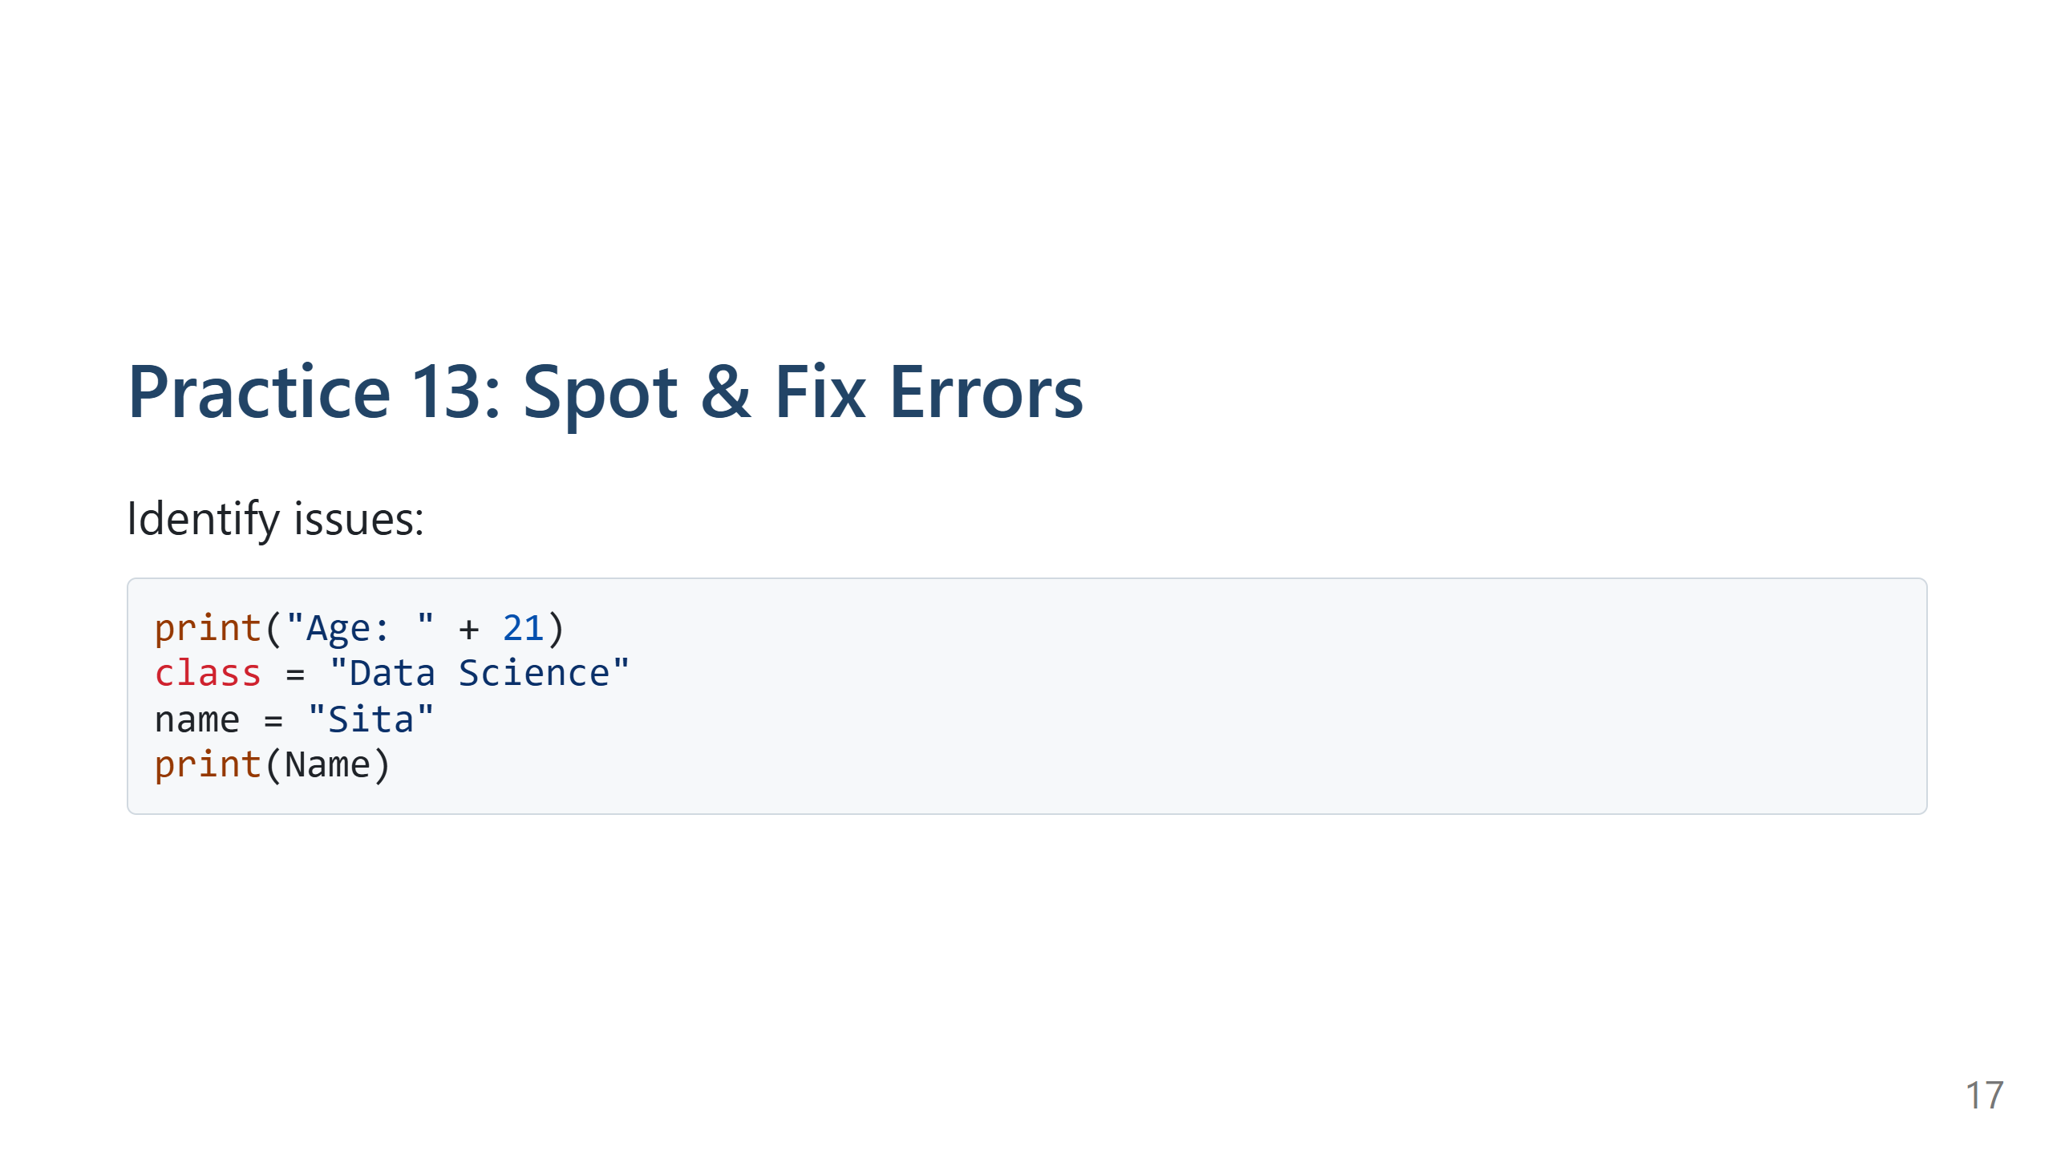
Notes:
Speaker Notes:
Fixes:
print("Age:", 21)
course = "Data Science"
name = "Sita"
print(name)
Errors: TypeError, keyword, indentation, NameError (case).

Slide 18
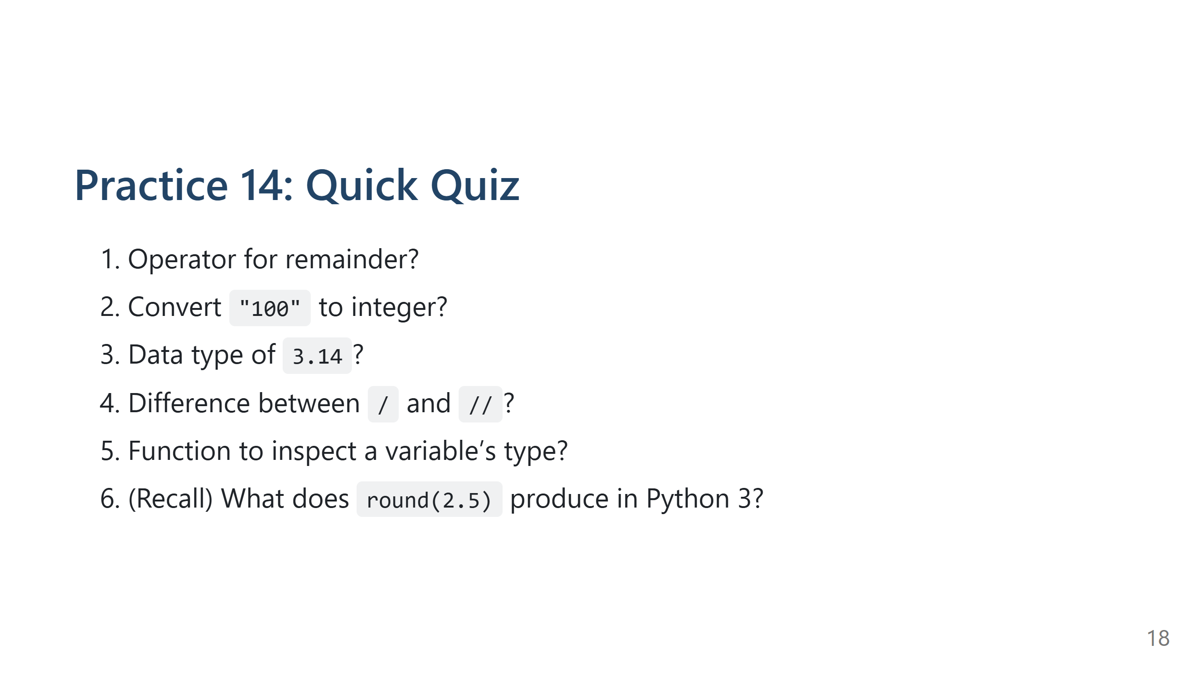
Notes:
Speaker Notes:
Answers: %, int("100"), float, / float division vs // floor division, type(), 2.

Slide 19
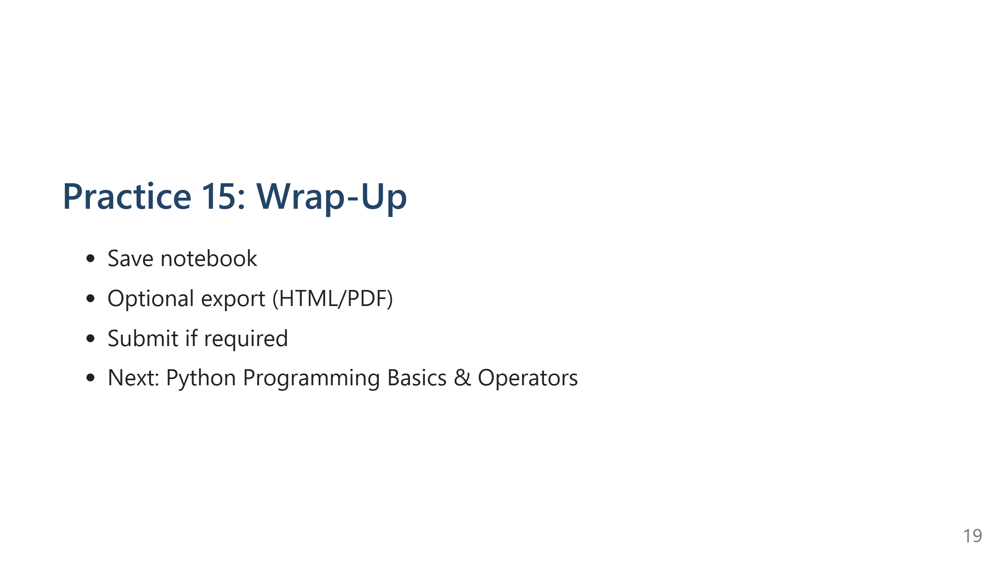
Notes:
Speaker Notes:
Encourage reflection & consistency in practice.

Slide 20
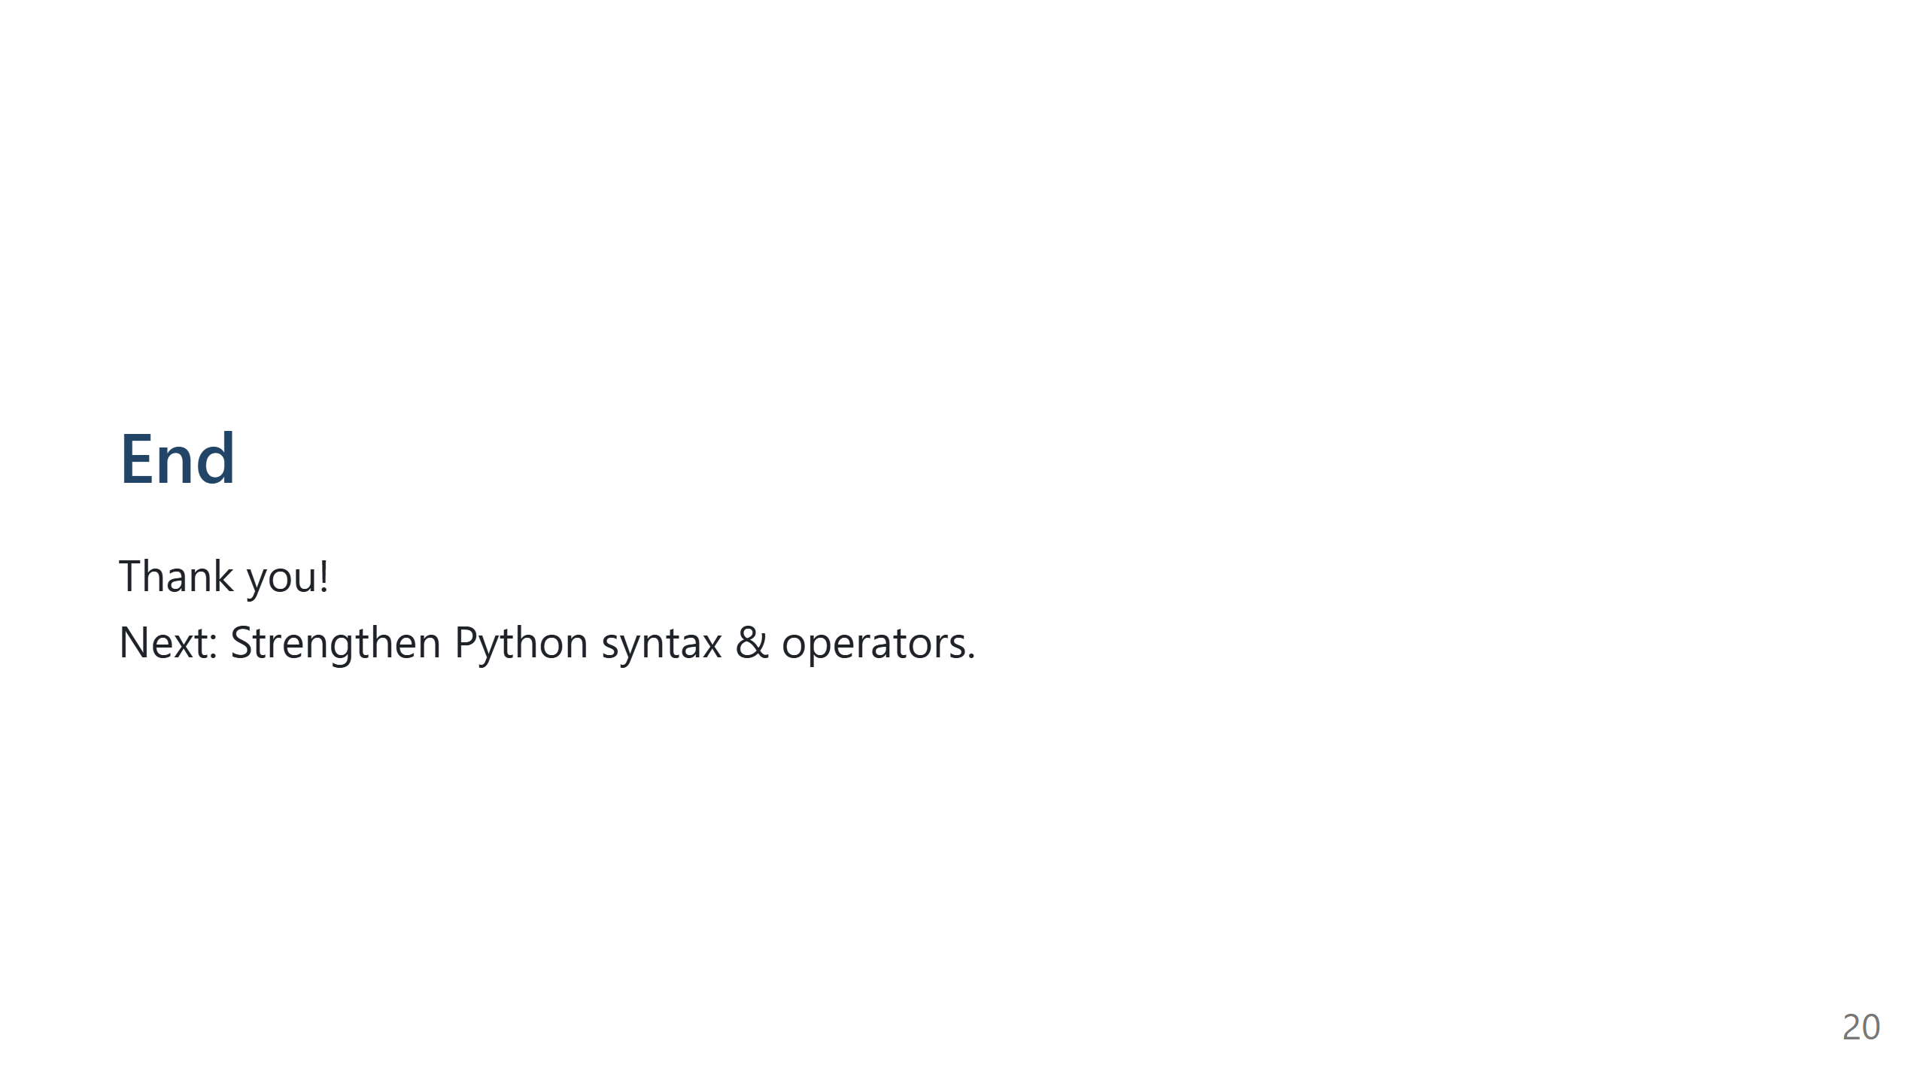
Notes:
Speaker Notes:
Close with motivational note about daily coding.

